Slide 1
Bank Security
DevSecOps
#WhatWhyHowWhoWhen
CyberCon 2022
Vince King

Slide 2
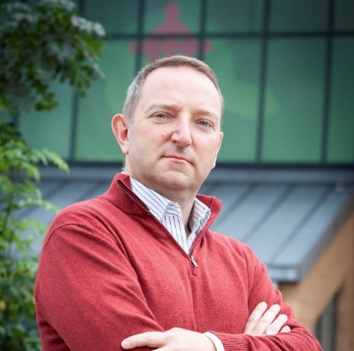





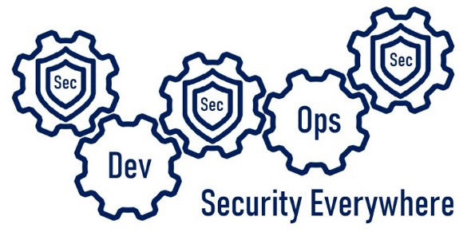

Who’s this talking to me now?
Vincent King
Senior Cyber Analyst
Head of DevSecOps
Bank of England
Vincent.king@bankofengland.co.uk
Reformed Developer
Secure Coding Subject Matter Expert
Qualys Certified Specialist
(ISC)² Certified Information Security Professional
DevSecOpsVince
Notes:
Reformed developer
Leading DevSecOps
Is – What – Why – How – Who – When
Not - tooling or vendors – in-depth course - silver bullet

Slide 3




#DevSecOpsWhat
Notes:
Buzz words – Agile - Cloud Migration - Digital Transformation – Zero Trust - DevSecOps.
Automation of the series of steps needed to take code from a repository to a production environment
Decrease attack surface
Combination of people, process, and technology.

Slide 4








#DevSecOpsWhy
Shifting Left
Notes:
Shift Left - Hackers now adopting it
House – Whole street - water taps – each house – manhole
Whole estate – each manhole - main supply
Whole town - water plant – reservoir - our source
Controls - not protecting
DevSecOps produce and protect code from development, to repo, through build and deployment, to production
Poison the Cloud and cause toxic rain

Slide 5






#DevSecOpsHow
Culture
Infrastructure
Secure code training
Peer reviews
Unit testing
Coding champion
Threat modelling
Coding standards
First warning … stop reading!
Image library source
Server hardening
Patching
Gold image curation
Networks and firewalls
Automatic provisioning
Developer Tooling
Monitoring
DevSecOps
IDE
Package Management
Application Lifecycle Management
Ticketing system
DAST tooling
Source control
Logging
Metrics
Analysis
Reporting
Threat intelligence
Evidence as policy
Slide isn’t meant to be read
Process Chain
(abridged!)
Deployment
Operations
Build pipelines
SAST tooling
Automated testing
Deployment environments
Automatic fault reporting
DAST tooling
Secrets management
Stop reading this slide!
Support
Service desk
Continuous monitoring
Vulnerability management
Security scanning
Policy enforcement
Notes:
Google - borehole - fallout shelter
Anti-best practice slides – don’t read
Rush out and buy tools - we need people, processes, and technology.
There are a lot of options!

Slide 6
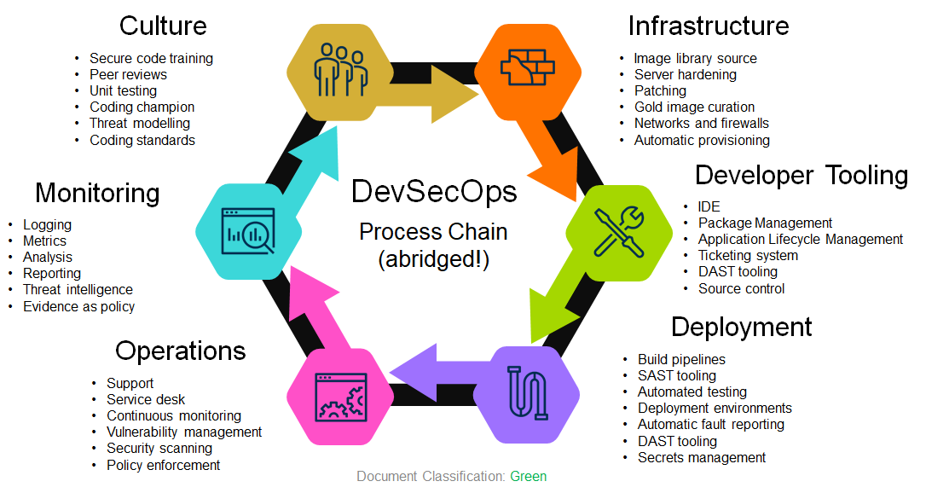
#DevSecOpsHow
The DevSecOps
Toolchain
Infrastructure
Culture
Azure Virtual Machines
Amazon Machine Images
GCP Compute Engine
Docker
ECR
Terraform
YAML
Ansible
Chef
SaltStack
AWS CloudFormation
Azure Resource Manager
CIS Benchmarks
SCCM
Qualys Patch Management
Automatic Updates
Code Warrior
Pluralsight
OWASP Top 10
LinkedIn Learning
Udemy
Evil user stories
CERT Secure Coding Standards
Game day exercises
Gerrit
Github pull requests
Review board
JUnit
xUnit
Evil user stories
OWASP Threat Dragon
CERT Secure Coding Standards
Monitoring
Developer Tooling
Azure Defender for Cloud
Azure Sentinel
Splunk
SolarWinds
RSA NetWitness
Archer
ThreatConnect
OWASP Threat Dragon
Chef
HashiCorp Sentinel
nmap
Etsy Morgue
Orca Security
HackerOne
graphite
Wiz.io
NPM
NodeJS
SonarLint
DeepSource
SonarQube
JetBrains
Github
GitLab
BitBucket
Azure DevOps
Github Actions
JIRA
Artifactory
ReSharper
Final warning! Stop it!
VSCode
Operations
Deployment
BMC Remedy
ServiceNow
LinkedIn Learning
Udemy
Evil user stories
OWASP Threat Dragon
CERT Secure Coding Standards
Qualys
Tenable
Spiceworks
BeyondTrust
AWS CloudTrail
Nessus
Seriously … stop reading! You will hurt your eyes.
Jenkins
Azure DevOps
AWS Deploy
VeraCode
Fortify
Selenium
TestComplete
Azure Key Vault
AWS KMS
Atlassian Bamboo
TeamCity
YAML
PowerShell
SARIF SAST Tools
Yarn
Test Management
(VERY abridged!)
Notes:
Leads to another problem – overwhelming
Start small and build. RT2 and Cloud Transformation - bake-in security
Tools and processes – IaC
Use native resources in the Cloud.
Setting policies - without limiting innovation.
Enable secure, reliable, and repeatable deployments for our operational teams and the Business.

Slide 7





#DevSecOpsWho
Ops
Ops
Dev
Sec
Dev
Sec
On
Prem
Cloud
RT2
Cloud
Notes:
A lot of work
Small core team - support Technology/Business
Wiz.io, for a PoC - Cloud Security Posture Management - areas of concern
Not all Cloud - working with on premise application to support SDLC

Slide 8



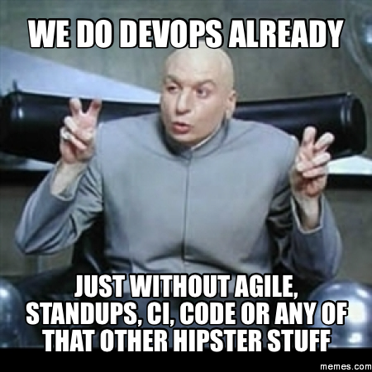



#DevSecOpsWhen
Notes:
Every presentation needs a meme
Already started - identify our maturity
Some developer teams - secure working practices
Fewer have integrated build and deployment pipelines
Fewer still have automated tasks for testing and code review.
Plan and prioritise the most effective next steps.
Will we ever be Netflix or Microsoft?
Start small, implement change, and always review
Security as an enabler, helping produce better architecture, more secure code, better role-based security. But it’s going to take time.

Slide 9
Questions

